Slide 1
第 1 章 Chapter 1
质点运动学
Kinematics of a Particle
用矢量和微积分描述运动，用模型解决机器人中的实际问题
Describing motion with vectors and calculus, and modelling real robot problems
大学物理A（上） University Physics A (I) · 2026 秋 Fall 2026
Notes:
开场问题：机器人怎样知道自己跑多快、往哪里走？引出位置矢量。
Opening question: how does a robot know how fast it is moving and where it is heading?

Slide 2
本章内容与每节课的结构
Chapter map and how each lesson works
1.1
参考系、坐标系与质点
Reference frames, coordinates and particles
机器人问题：传送带跟踪抓取
Robot: Grasping from a moving conveyor
1.2
位矢、位移、速度、加速度
Position, displacement, velocity, acceleration
机器人问题：移动机器人的里程计
Robot: Odometry of a mobile robot
1.3
抛体运动
Projectile motion
机器人问题：投篮机器人
Robot: A basketball-shooting robot
1.4
圆周运动
Circular motion
机器人问题：AGV 转弯限速
Robot: AGV cornering speed limit
1.5
相对运动
Relative motion
机器人问题：无人机侧风航线修正
Robot: Drone crosswind correction
每节课：实际问题 → 概念 → 动画 → 虚拟实验 → 建模求解 Each lesson: problem → concept → animation → virtual lab → modelling
Notes:
物理学通过建立模型来观察和描述世界。本章每节课都从一个机器人实际问题出发，最后回到这个问题，用本节的模型解决它。
Physics describes the world through models. Each lesson starts from a robot problem and returns to solve it with that lesson’s model.

Slide 3
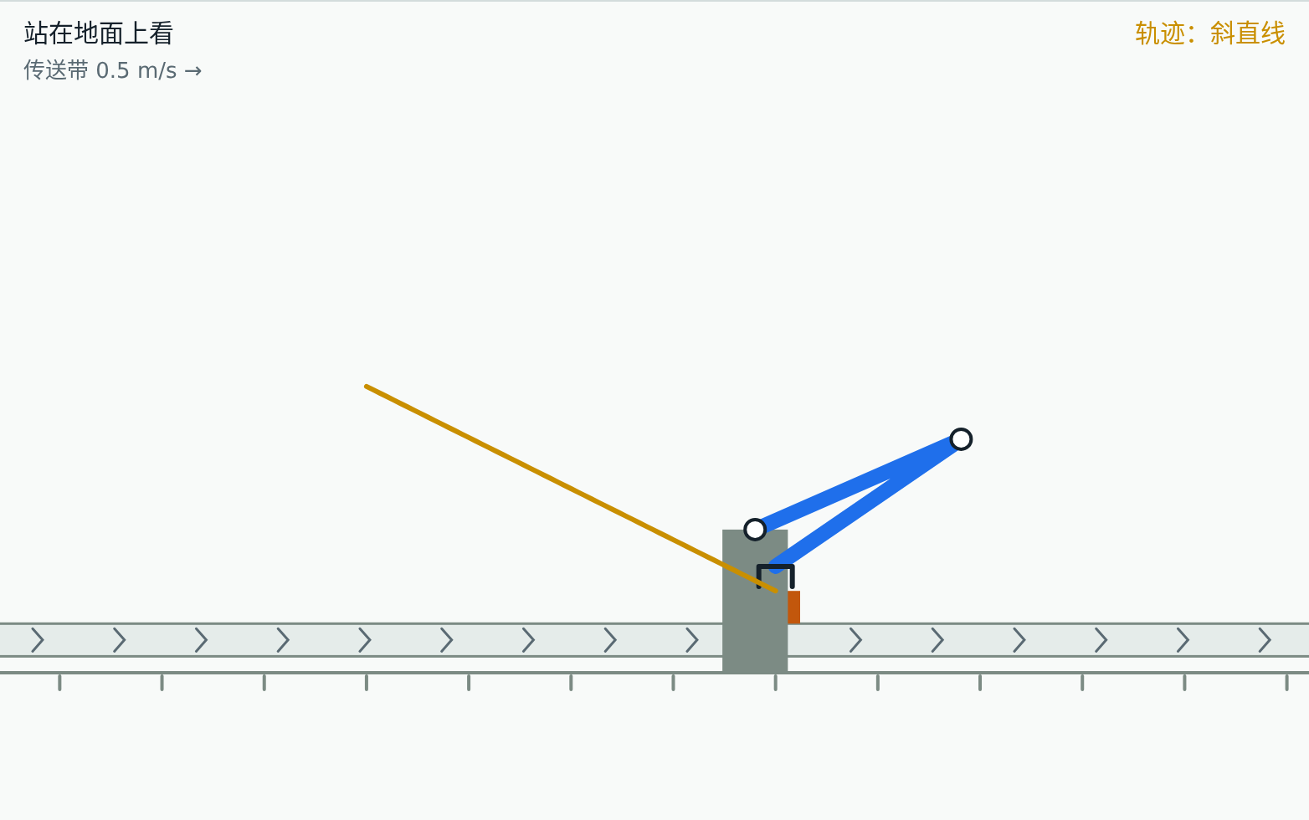
1.1 机器人问题 Robot problem
传送带跟踪抓取
Grasping from a moving conveyor
工件在传送带上以 0.50 m/s 运动，机械臂要在运动中抓住它。在哪个参考系里规划抓取最简单？末端对地速度应是多少？
A part rides the belt at 0.50 m/s and the arm must grab it on the move. In which frame is the grasp easiest to plan, and what must the gripper’s ground velocity be?
已知 Given
传送带速度 u = 0.50 m/s
belt speed u = 0.50 m/s
末端相对传送带竖直下降 0.25 m/s
gripper descends at 0.25 m/s relative to the belt
下降距离 0.50 m
descent 0.50 m
本节结束时，我们用建立的模型回答这个问题。 We will answer it with this lesson’s model at the end.
Notes:
先让学生猜一猜、讨论 2 分钟，不急于给答案。本节最后回到这一页。
Let students guess and discuss for two minutes; do not give the answer yet. Return to this problem at the end of the lesson.

Slide 4
1.1 概念 Concept
参考系：运动是相对的
Reference frames: motion is relative
描述运动必须先选定参考系；同一运动在不同参考系中看来不同
Choose a frame first; one motion looks different in different frames
在参考系上建立坐标系：直角坐标系、自然坐标系
Set up coordinates: Cartesian or path (natural) coordinates
质点：形状和大小可以忽略时，把物体看成有质量的点
Particle: ignore size and shape when they do not matter
速度叠加：v(对地) = v(相对) + v(牵连)
Velocity addition: v(ground) = v(relative) + v(frame)
描述运动 = 参考系 + 坐标系 + 研究对象（质点）
Motion = frame + coordinates + object (particle)
Notes:
讲清公式的物理意义，再进入动画。
Explain the physical meaning of each formula before the animation.

Slide 5
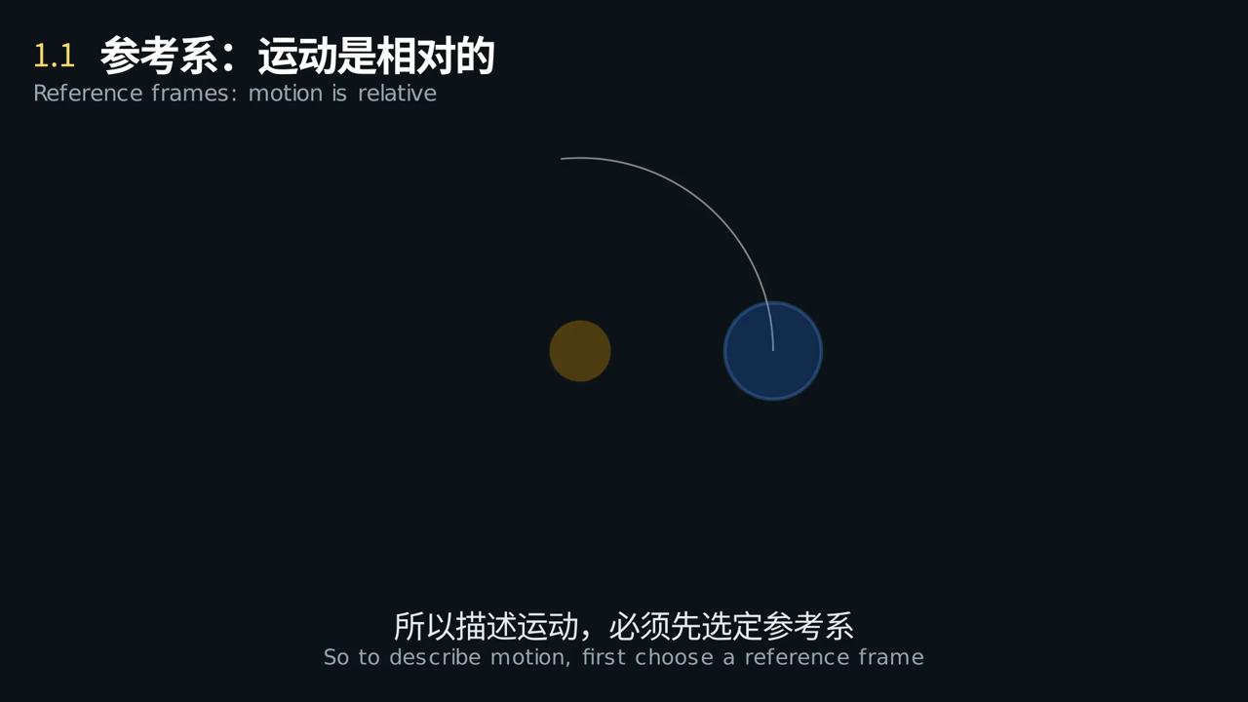
1.1 动画 Animation
车厢里的人和地面上的人，看到的小球轨迹为什么不同？
Why do the passenger and the person on the ground see different paths?
点击画面播放 · 中英字幕 · Click to play · bilingual captions
Notes:
播放动画，在关键画面暂停提问。
Play the clip and pause at the key frame to ask the question on the slide.

Slide 6
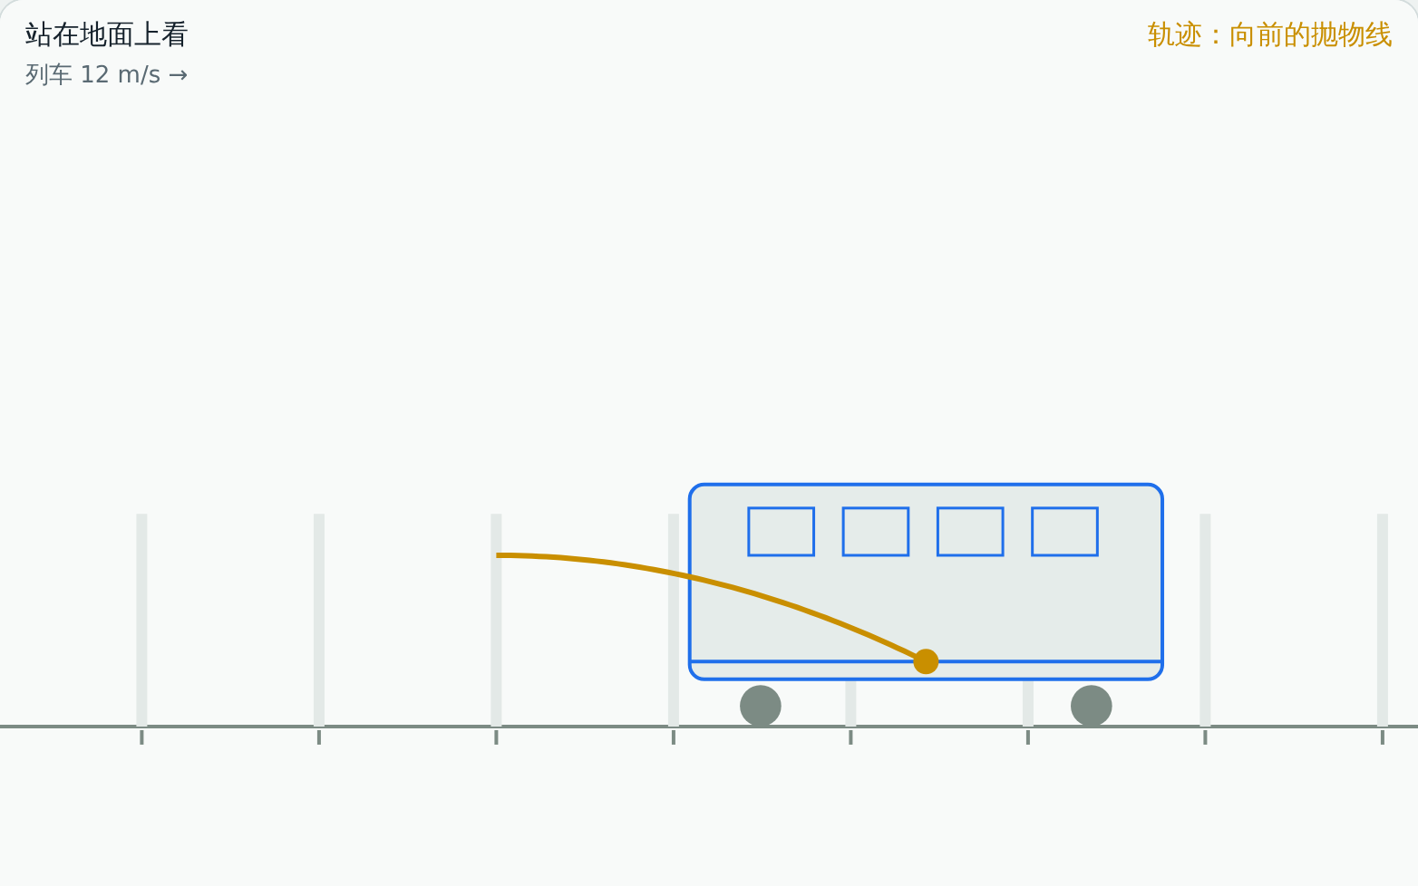
1.1 虚拟实验 Virtual lab
动手试一试：参考系、坐标系与质点
Try it: Reference frames, coordinates and particles
任务 Tasks
传送带参考系：末端竖直落到工件上
Belt frame: gripper comes straight down
地面参考系：读出末端对地速度和方向
Ground frame: read the gripper’s ground velocity
列车：找一个观察者看到小球向后抛出
Train: find an observer who sees the ball go backwards
打开虚拟实验 Open lab ▶
课后按实验指导书完成实验报告 · Write the lab report using the lab guide
Notes:
课堂投屏演示一遍机器人场景，其余任务课后完成，并按实验指导书写实验报告。
Demonstrate the robot scene in class; students finish the tasks and the lab report after class.

Slide 7
1.1 回到实际问题 Back to the problem
建模求解：传送带跟踪抓取
Modelling: Grasping from a moving conveyor
步骤 Step | 内容 What we do
① 问题 Problem | 工件在传送带上以 0.50 m/s 运动，机械臂要在运动中抓住它。在哪个参考系里规划抓取最简单？末端对地速度应是多少？ A part rides the belt at 0.50 m/s and the arm must grab it on the move. In which frame is the grasp easiest to plan, and what must the gripper’s ground velocity be?
② 建模 Model | 工件、末端看成质点；传送带匀速；末端相对传送带竖直下降 0.25 m/s Part and gripper as particles; belt at constant speed; gripper descends 0.25 m/s relative to the belt
③ 求解 Solve | v(对地) = (0.50, −0.25) m/s，大小 0.56 m/s，向下偏 26.6°。若只对地竖直下降，2.0 s 内工件滑过 1.0 m，抓不到 v(ground) = (0.50, −0.25) m/s: 0.56 m/s, 26.6° below horizontal. Descending straight down relative to the ground, the part slides 1.0 m past in 2.0 s
④ 检验 Check | 虚拟实验 1.1“传送带抓取”：两个参考系中分别观察轨迹、读对地速度 Lab 1.1 “conveyor grasp”: compare the path in both frames and read the ground velocity
⑤ 修正 Improve | 传送带速度有波动，要用编码器或视觉实时跟踪；抓取前后的加减速也要规划 Belt speed varies, so track it with an encoder or camera; plan the acceleration before and after the grasp
生活中的例子
Everyday example
雨天车窗上的雨痕：雨滴下落 7 m/s、车速 20 m/s，雨痕与竖直方向约成 71°（tanα = 20/7）
Rain streaks on a car window: raindrops at 7 m/s, car at 20 m/s, streaks about 71° from vertical (tanα = 20/7)
物理学通过建立模型来观察和描述世界：先简化，再求解，再用实验检验，最后找出模型的局限。
Physics describes the world through models: simplify, solve, test, then find where the model breaks.
Notes:
对照五步讲解，强调第⑤步：模型在哪里失效。实验报告第六部分按这五步写。
Walk through the five steps and stress step ⑤, where the model fails. Section 6 of the lab report follows the same steps.

Slide 8
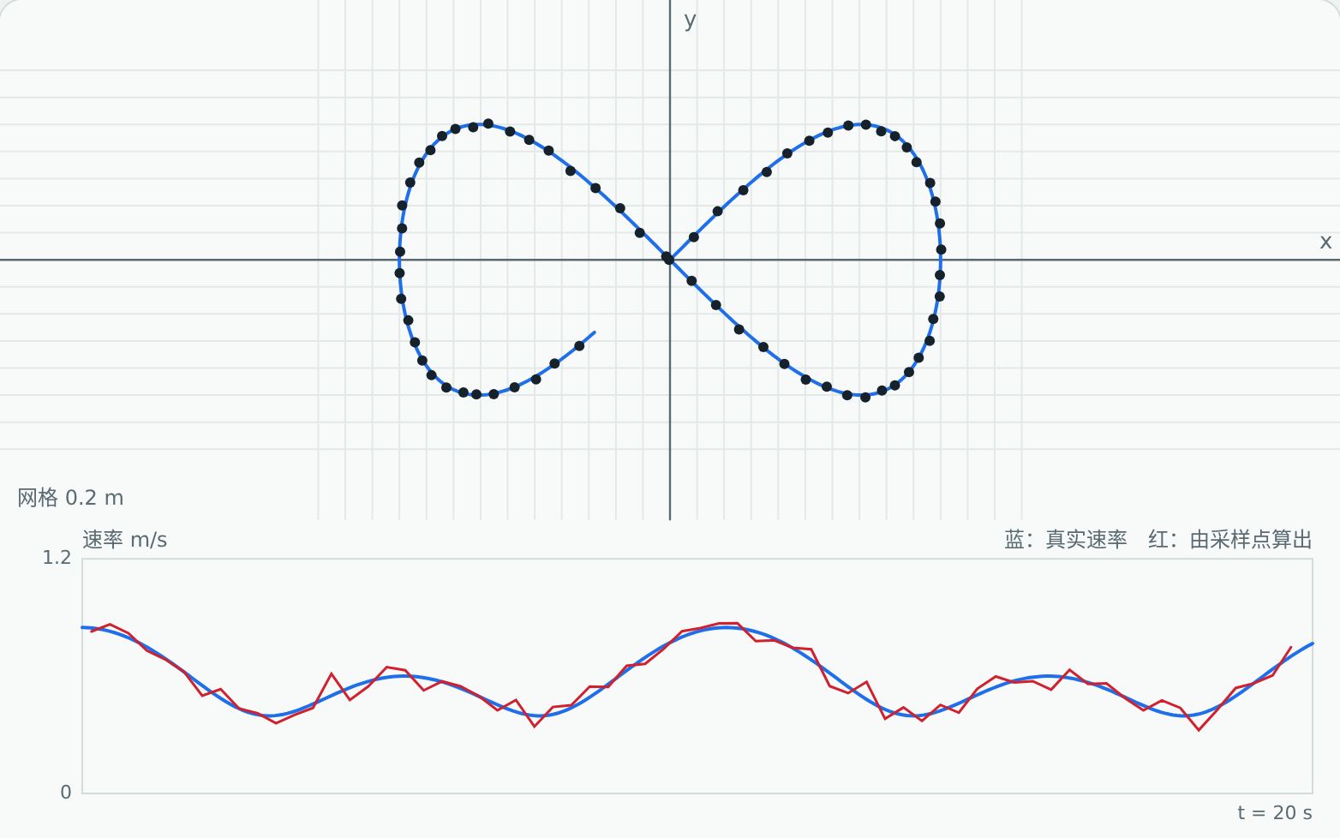
1.2 机器人问题 Robot problem
移动机器人的里程计
Odometry of a mobile robot
仓储机器人每隔 T 记录一次自己的位置，用相邻两点的位移除以 T 算速度。采样间隔 T 该怎么选？
A warehouse robot logs its position every T seconds and divides the displacement between samples by T to get speed. How should T be chosen?
已知 Given
定位误差 σ ≈ 1 cm
position error σ ≈ 1 cm
行驶速度约 0.5 m/s
speed about 0.5 m/s
要求速率误差 < 5%
speed error must be < 5%
本节结束时，我们用建立的模型回答这个问题。 We will answer it with this lesson’s model at the end.
Notes:
先让学生猜一猜、讨论 2 分钟，不急于给答案。本节最后回到这一页。
Let students guess and discuss for two minutes; do not give the answer yet. Return to this problem at the end of the lesson.

Slide 9
1.2 概念 Concept
速度与加速度：对位矢求导
Velocity and acceleration: derivatives of position
位矢 r(t) 完整描述质点的位置
The position vector r(t) fully describes where the particle is
位移 Δr 是矢量，路程 Δs 是标量，一般 |Δr| ≠ Δs
Displacement Δr is a vector, path length Δs a scalar; in general |Δr| ≠ Δs
速度沿轨迹切线方向，速率是 ds/dt
Velocity is tangent to the path; speed is ds/dt
已知加速度求运动方程：积分 + 初始条件
From acceleration to motion: integrate with initial conditions
v = dr/dt a = dv/dt = d²r/dt²
Notes:
讲清公式的物理意义，再进入动画。
Explain the physical meaning of each formula before the animation.

Slide 10
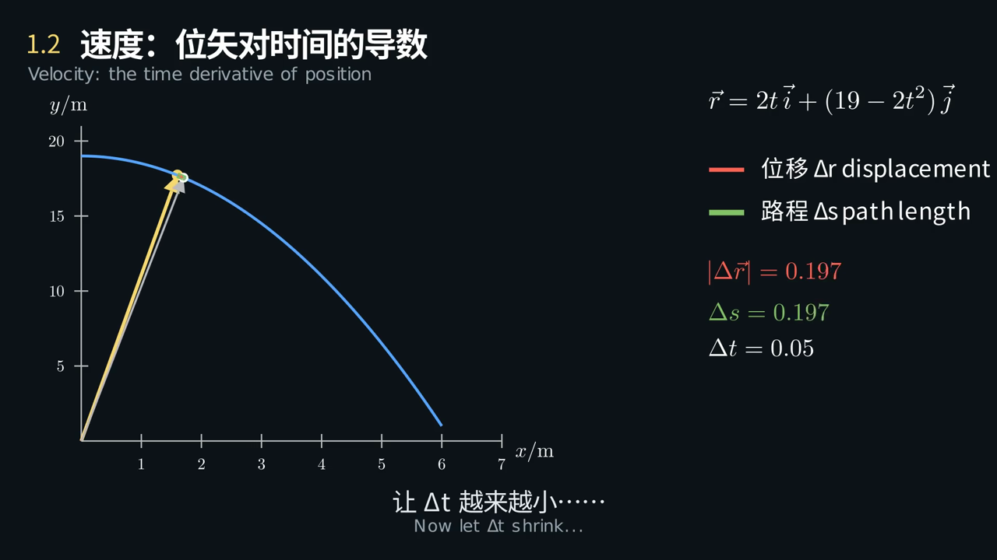
1.2 动画 Animation
Δt 越来越小时，弦 Δr 怎样变成切线方向的速度？
As Δt shrinks, how does the chord Δr turn into the tangent velocity?
点击画面播放 · 中英字幕 · Click to play · bilingual captions
Notes:
播放动画，在关键画面暂停提问。
Play the clip and pause at the key frame to ask the question on the slide.

Slide 11
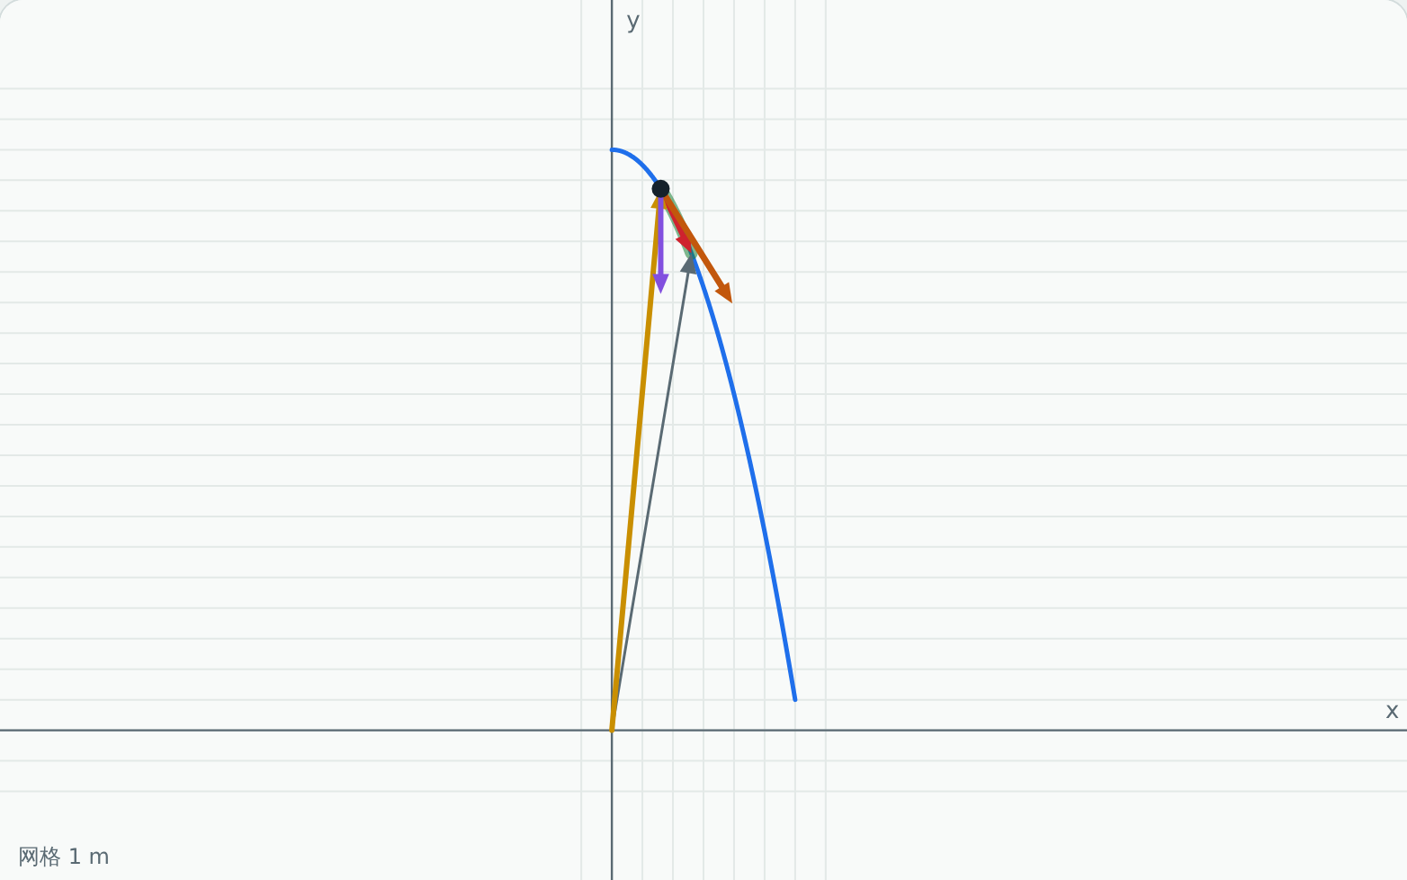
1.2 虚拟实验 Virtual lab
动手试一试：位矢、位移、速度、加速度
Try it: Position, displacement, velocity, acceleration
任务 Tasks
里程计：σ = 1 cm 时，找出误差 < 5% 的采样间隔
Odometry: find an interval with < 5% error at σ = 1 cm
里程计：T < 0.05 s，观察噪声放大
Odometry: T < 0.05 s, watch the noise grow
例1-1：t = 1 s 时验证 v = 2i − 4j
Example 1-1: check v = 2i − 4j at t = 1 s
打开虚拟实验 Open lab ▶
课后按实验指导书完成实验报告 · Write the lab report using the lab guide
Notes:
课堂投屏演示一遍机器人场景，其余任务课后完成，并按实验指导书写实验报告。
Demonstrate the robot scene in class; students finish the tasks and the lab report after class.

Slide 12
1.2 回到实际问题 Back to the problem
建模求解：移动机器人的里程计
Modelling: Odometry of a mobile robot
步骤 Step | 内容 What we do
① 问题 Problem | 仓储机器人每隔 T 记录一次自己的位置，用相邻两点的位移除以 T 算速度。采样间隔 T 该怎么选？ A warehouse robot logs its position every T seconds and divides the displacement between samples by T to get speed. How should T be chosen?
② 建模 Model | 机器人为质点；定位误差 σ ≈ 1 cm，各次独立；v ≈ |Δr| / T Robot as a particle; independent position errors σ ≈ 1 cm; v ≈ |Δr| / T
③ 求解 Solve | 噪声引起的速率误差 ≈ √2·σ/T；要小于 5% × 0.5 m/s，得 T ≥ 0.57 s Noise error ≈ √2·σ/T; below 5% of 0.5 m/s requires T ≥ 0.57 s
④ 检验 Check | 虚拟实验 1.2“里程计数据”：T 从 0.02 s 调到 1.5 s，误差先降后升 Lab 1.2 “odometry”: sweep T from 0.02 s to 1.5 s; the error falls, then rises
⑤ 修正 Improve | T 太大时以弦代弧、速度滞后；实际用滤波融合轮速计和惯性测量单元，得到又稳又快的速度 Large T cuts corners and lags; real robots filter and fuse wheel encoders with an IMU
生活中的例子
Everyday example
手机导航每秒一个 GPS 点、误差几米，显示的车速经过平滑滤波，所以比定位点稳定
Phone navigation gets one GPS fix per second with metres of error; the speed shown is filtered, so it is steadier than the fixes
物理学通过建立模型来观察和描述世界：先简化，再求解，再用实验检验，最后找出模型的局限。
Physics describes the world through models: simplify, solve, test, then find where the model breaks.
Notes:
对照五步讲解，强调第⑤步：模型在哪里失效。实验报告第六部分按这五步写。
Walk through the five steps and stress step ⑤, where the model fails. Section 6 of the lab report follows the same steps.

Slide 13
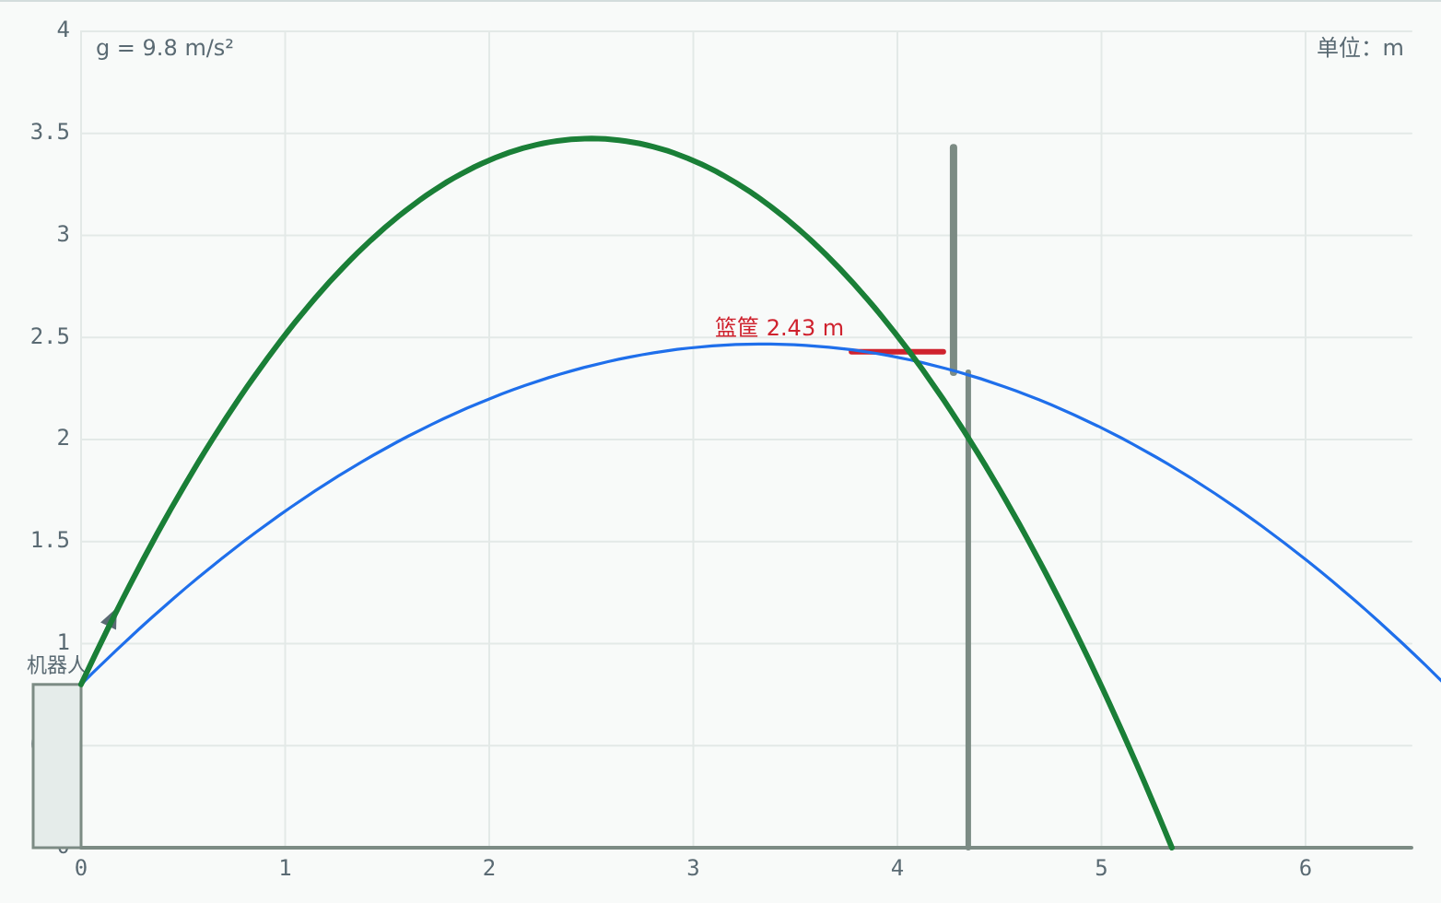
1.3 机器人问题 Robot problem
投篮机器人
A basketball-shooting robot
比赛用投篮机器人：出手点高 0.8 m，篮筐高 2.43 m、水平距离 4 m。给定出手角度，出手速度应是多少？角度大一些好还是小一些好？
A competition robot releases the ball at 0.8 m; the hoop is 2.43 m high and 4 m away. For a given angle, what launch speed is needed? Is a steeper or flatter shot better?
已知 Given
出手高 0.8 m
release height 0.8 m
篮筐高 2.43 m、距离 4 m
hoop 2.43 m high, 4 m away
发射速度误差 ±0.1 m/s
launcher speed error ±0.1 m/s
本节结束时，我们用建立的模型回答这个问题。 We will answer it with this lesson’s model at the end.
Notes:
先让学生猜一猜、讨论 2 分钟，不急于给答案。本节最后回到这一页。
Let students guess and discuss for two minutes; do not give the answer yet. Return to this problem at the end of the lesson.

Slide 14
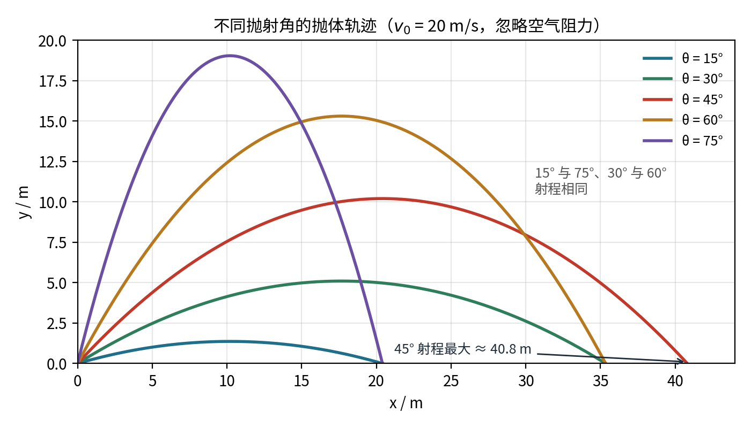
1.3 概念 Concept
抛体运动
Projectile motion
只受重力：a = −g j（忽略空气阻力）
Gravity only: a = −g j (no air drag)
水平方向匀速，竖直方向匀加速
Uniform horizontally, uniformly accelerated vertically
轨迹是抛物线
The path is a parabola
h₀ = 0 时 45° 射程最大；互余角射程相同
With h₀ = 0, 45° goes farthest; complementary angles give equal range
x = v₀cosθ·t y = h₀ + v₀sinθ·t − ½gt²
R = v₀² sin2θ / g (h₀ = 0)
Notes:
讲清公式的物理意义，再进入动画。
Explain the physical meaning of each formula before the animation.

Slide 15
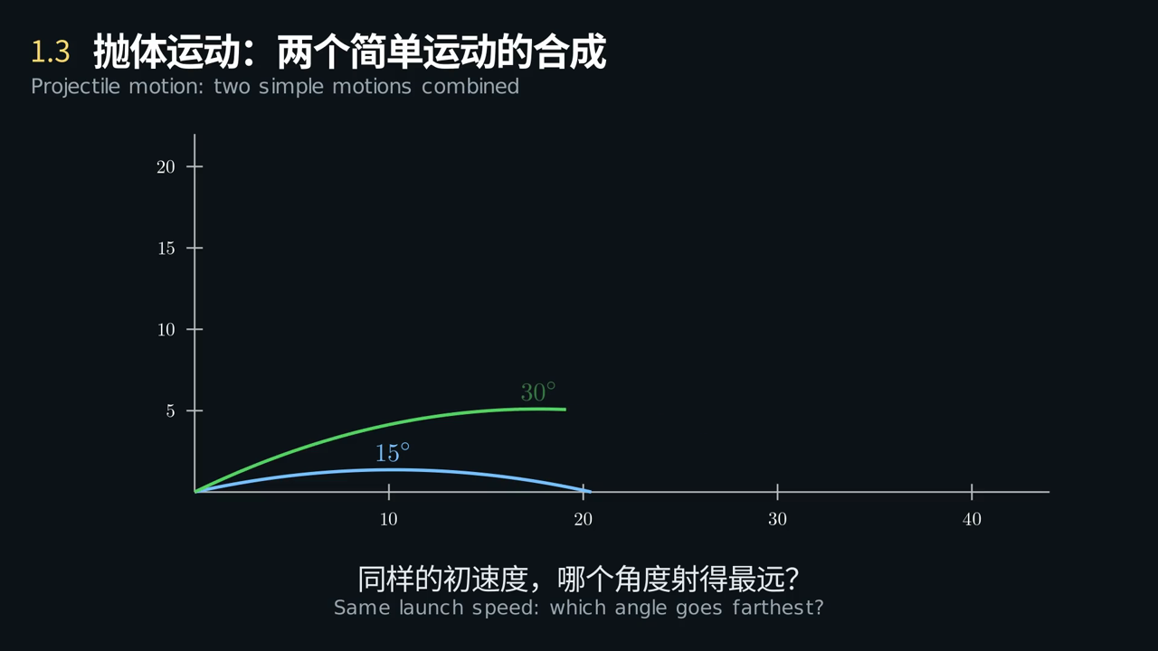
1.3 动画 Animation
把抛体运动投影到两个坐标轴上，你看到了哪两种运动？
Project the motion onto the two axes: which two motions do you see?
点击画面播放 · 中英字幕 · Click to play · bilingual captions
Notes:
播放动画，在关键画面暂停提问。
Play the clip and pause at the key frame to ask the question on the slide.

Slide 16
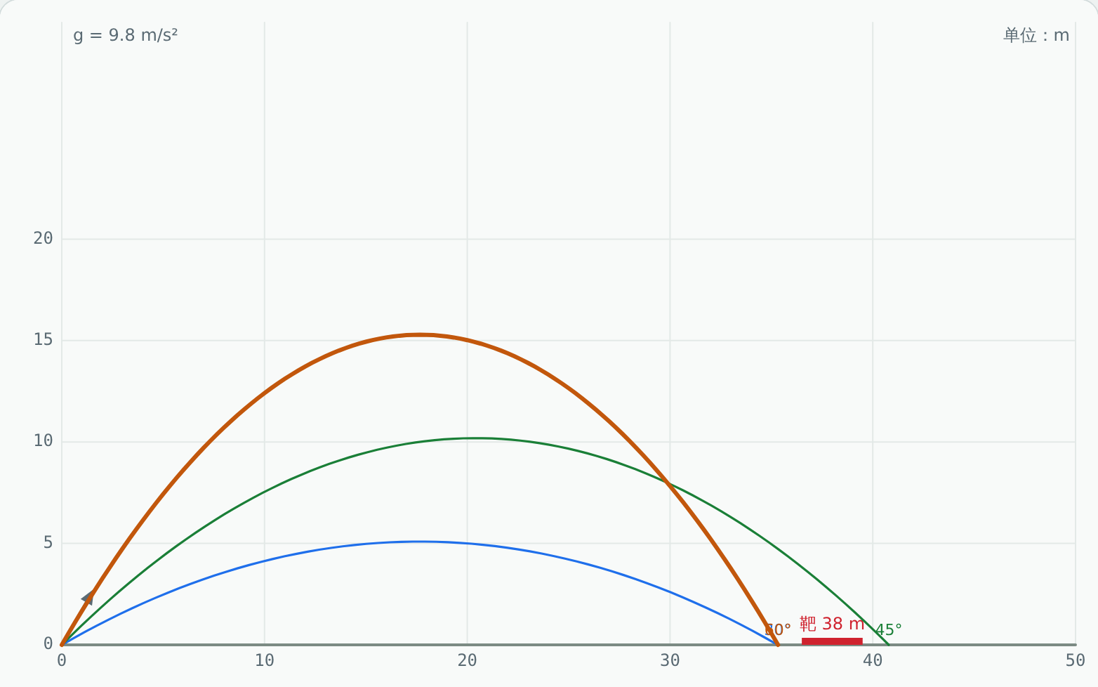
1.3 虚拟实验 Virtual lab
动手试一试：抛体运动
Try it: Projectile motion
任务 Tasks
投篮：让球从上方落入篮筐
Basket: drop the ball through the hoop
投篮：两个角度都投进，比较所需速度
Basket: score at two angles, compare speeds
打开空气阻力：最佳角度还是 45° 吗？
With drag on: is 45° still best?
打开虚拟实验 Open lab ▶
课后按实验指导书完成实验报告 · Write the lab report using the lab guide
Notes:
课堂投屏演示一遍机器人场景，其余任务课后完成，并按实验指导书写实验报告。
Demonstrate the robot scene in class; students finish the tasks and the lab report after class.

Slide 17
1.3 回到实际问题 Back to the problem
建模求解：投篮机器人
Modelling: A basketball-shooting robot
步骤 Step | 内容 What we do
① 问题 Problem | 比赛用投篮机器人：出手点高 0.8 m，篮筐高 2.43 m、水平距离 4 m。给定出手角度，出手速度应是多少？角度大一些好还是小一些好？ A competition robot releases the ball at 0.8 m; the hoop is 2.43 m high and 4 m away. For a given angle, what launch speed is needed? Is a steeper or flatter shot better?
② 建模 Model | 球为质点，忽略空气阻力和旋转；出手点 (0, 0.8 m)，篮筐 (4 m, 2.43 m) Ball as a particle, no drag or spin; release (0, 0.8 m), hoop (4 m, 2.43 m)
③ 求解 Solve | v₀ = (X/cosθ)·√[g / (2(X tanθ − Δy))]：45° → 8.13 m/s，55° → 7.64 m/s，65° → 7.95 m/s v₀ = (X/cosθ)·√[g / (2(X tanθ − Δy))]: 45° → 8.13, 55° → 7.64, 65° → 7.95 m/s
④ 检验 Check | 虚拟实验 1.3“投篮”：按计算值发射；用 v₀ ± 0.1 m/s 再发射，45° 偏差约 ±0.3 m，65° 约 ±0.13 m Lab 1.3 “basket”: launch at the computed speed; with v₀ ± 0.1 m/s the miss is about ±0.3 m at 45° but ±0.13 m at 65°
⑤ 修正 Improve | 高抛对速度误差不敏感、入射角大；还要考虑空气阻力、球的旋转和篮板反弹 A steep shot tolerates speed error and enters more steeply; drag, spin and the backboard also matter
生活中的例子
Everyday example
铅球：出手高 2 m、速度 13.5 m/s 时，最佳出手角约 42°，射程约 20.5 m，不是 45°
Shot put: released at 2 m and 13.5 m/s, the best angle is about 42° (range about 20.5 m), not 45°
物理学通过建立模型来观察和描述世界：先简化，再求解，再用实验检验，最后找出模型的局限。
Physics describes the world through models: simplify, solve, test, then find where the model breaks.
Notes:
对照五步讲解，强调第⑤步：模型在哪里失效。实验报告第六部分按这五步写。
Walk through the five steps and stress step ⑤, where the model fails. Section 6 of the lab report follows the same steps.

Slide 18
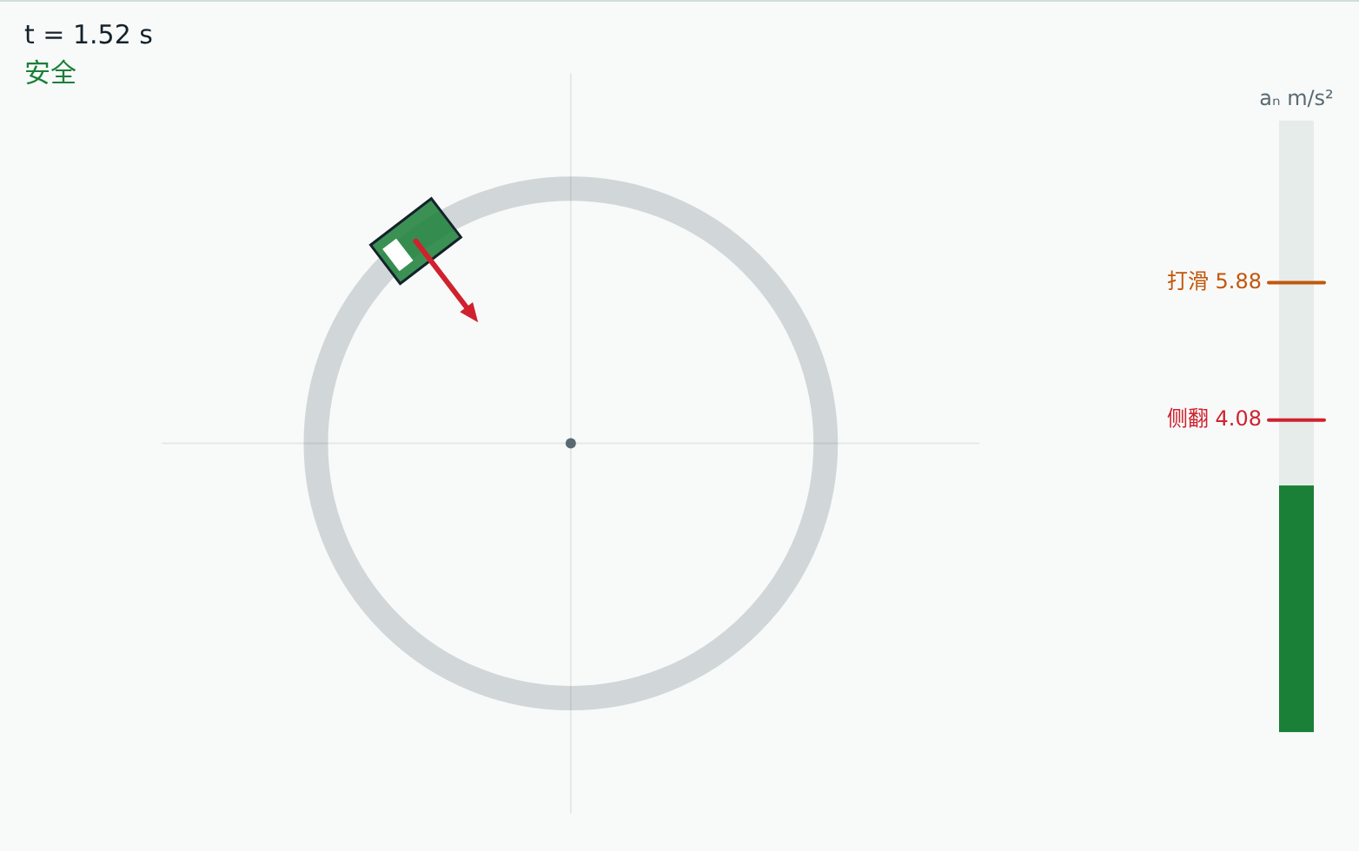
1.4 机器人问题 Robot problem
AGV 转弯限速
AGV cornering speed limit
仓储搬运机器人（AGV）载货后在通道拐弯。最快能开多快，才不会侧翻、不会打滑？
A loaded warehouse AGV turns a corner in an aisle. How fast can it go without tipping over or sliding?
已知 Given
转弯半径 1.5 m
turn radius 1.5 m
质心高 0.6 m，轮距 0.5 m
centre of mass 0.6 m high, track 0.5 m
摩擦因数 μ = 0.6
friction coefficient μ = 0.6
本节结束时，我们用建立的模型回答这个问题。 We will answer it with this lesson’s model at the end.
Notes:
先让学生猜一猜、讨论 2 分钟，不急于给答案。本节最后回到这一页。
Let students guess and discuss for two minutes; do not give the answer yet. Return to this problem at the end of the lesson.

Slide 19
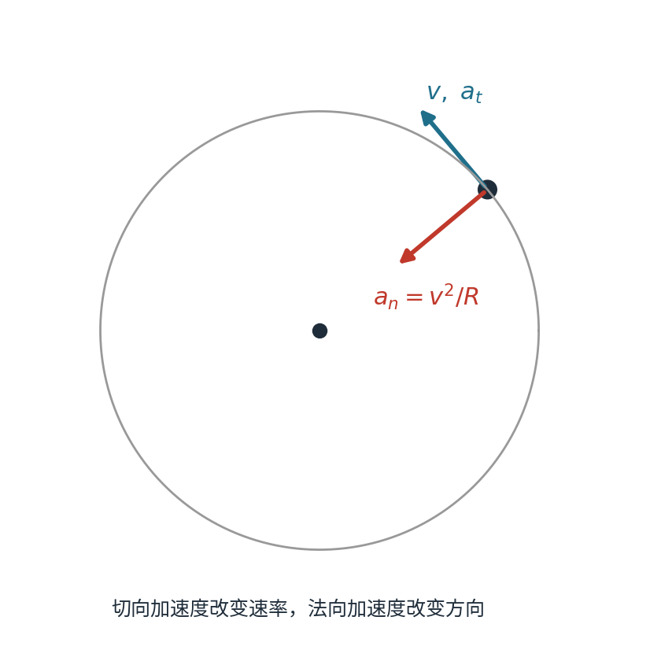
1.4 概念 Concept
圆周运动：两个加速度分量
Circular motion: two components of acceleration
切向加速度改变速率的大小
Tangential acceleration changes the speed
法向加速度指向圆心，改变速度的方向
Normal acceleration points to the centre and changes the direction
匀速圆周运动：aₜ = 0，aₙ ≠ 0
Uniform circular motion: aₜ = 0 but aₙ ≠ 0
角量与线量：v = Rω，aₜ = Rα，aₙ = Rω²
Angular and linear: v = Rω, aₜ = Rα, aₙ = Rω²
aₜ = dv/dt aₙ = v²/R
Notes:
讲清公式的物理意义，再进入动画。
Explain the physical meaning of each formula before the animation.

Slide 20
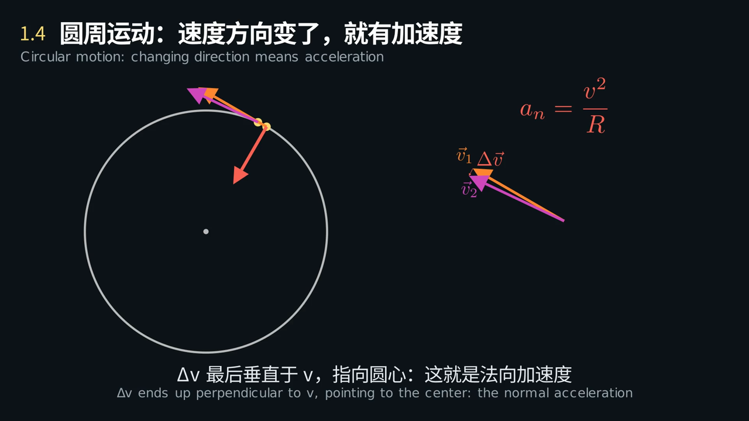
1.4 动画 Animation
速率不变，为什么还有加速度？Δv 最后指向哪里？
The speed is constant, so why is there an acceleration? Where does Δv point?
点击画面播放 · 中英字幕 · Click to play · bilingual captions
Notes:
播放动画，在关键画面暂停提问。
Play the clip and pause at the key frame to ask the question on the slide.

Slide 21
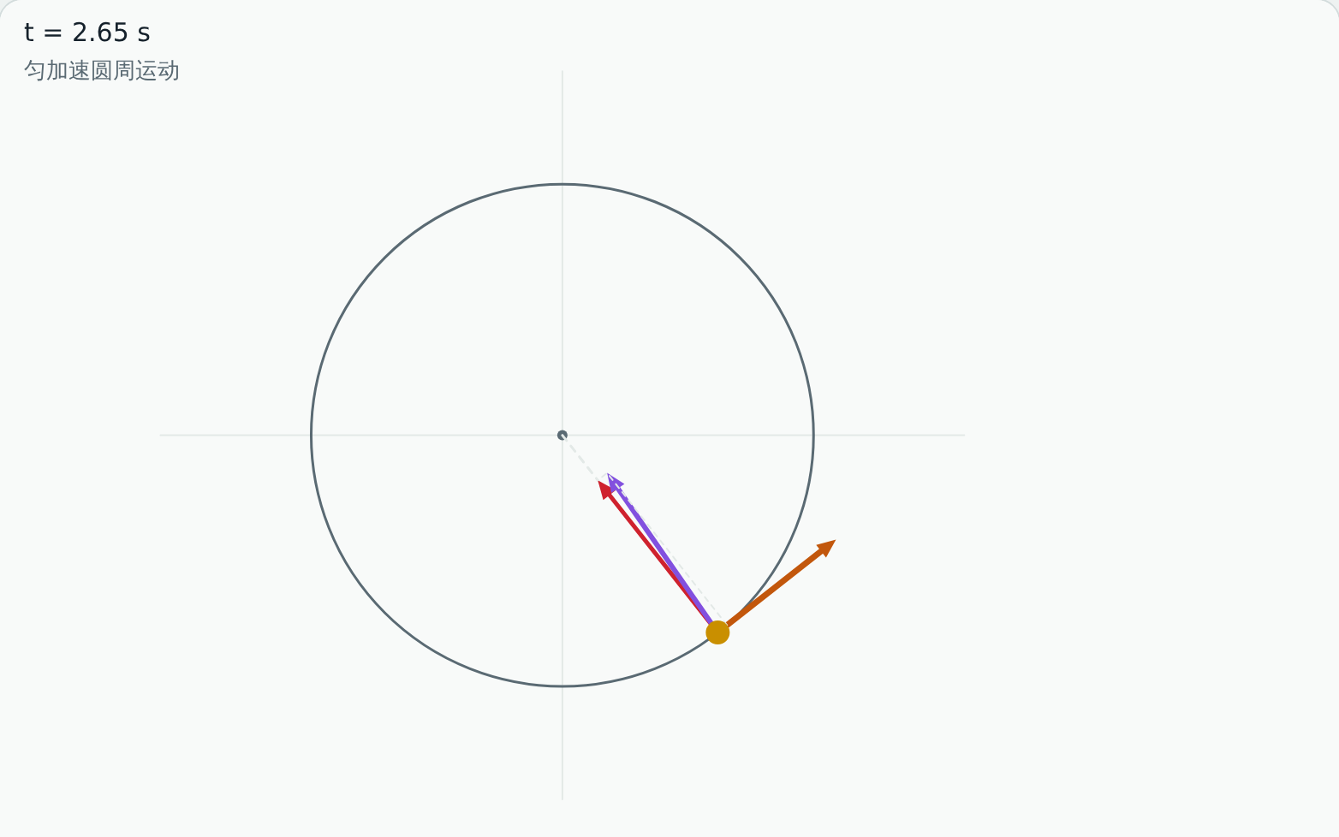
1.4 虚拟实验 Virtual lab
动手试一试：圆周运动
Try it: Circular motion
任务 Tasks
AGV：R = 1.5 m 时不侧翻的最大速度
AGV: highest speed without tipping at R = 1.5 m
AGV：再加速，先侧翻还是先打滑？
AGV: faster still—tip or slide first?
例1-3：读出 t = 2 s 时的 aₜ、aₙ
Example 1-3: read aₜ and aₙ at t = 2 s
打开虚拟实验 Open lab ▶
课后按实验指导书完成实验报告 · Write the lab report using the lab guide
Notes:
课堂投屏演示一遍机器人场景，其余任务课后完成，并按实验指导书写实验报告。
Demonstrate the robot scene in class; students finish the tasks and the lab report after class.

Slide 22
1.4 回到实际问题 Back to the problem
建模求解：AGV 转弯限速
Modelling: AGV cornering speed limit
步骤 Step | 内容 What we do
① 问题 Problem | 仓储搬运机器人（AGV）载货后在通道拐弯。最快能开多快，才不会侧翻、不会打滑？ A loaded warehouse AGV turns a corner in an aisle. How fast can it go without tipping over or sliding?
② 建模 Model | AGV 看成刚体做匀速圆周运动；地面摩擦提供向心力 AGV as a rigid body in uniform circular motion; friction provides the centripetal force
③ 求解 Solve | 不打滑 v ≤ √(μgR) = 2.97 m/s；不侧翻 v ≤ √(g·b/(2h)·R) = 2.47 m/s，先侧翻；若限 0.3g，v ≤ 2.10 m/s No sliding: v ≤ √(μgR) = 2.97 m/s; no tipping: v ≤ √(g·b/(2h)·R) = 2.47 m/s, so it tips first; at 0.3g, v ≤ 2.10 m/s
④ 检验 Check | 虚拟实验 1.4“AGV 转弯”：R = 1.5 m 逐渐加速，约 2.47 m/s 时出现“侧翻” Lab 1.4 “AGV turning”: at R = 1.5 m, speed up until it shows “tipping” at about 2.47 m/s
⑤ 修正 Improve | 货物晃动、制动时的切向加速度、地面湿滑都会降低限速；可降低质心、加宽轮距、弯道自动减速 Load sway, braking and wet floors lower the limit; lower the centre of mass, widen the track, slow down in curves
生活中的例子
Everyday example
高速公路弯道按侧向加速度 ≤ 0.2g 设计：R = 500 m 时 v ≈ 31 m/s ≈ 113 km/h
Highway curves are designed for ≤ 0.2g sideways: at R = 500 m, v ≈ 31 m/s ≈ 113 km/h
物理学通过建立模型来观察和描述世界：先简化，再求解，再用实验检验，最后找出模型的局限。
Physics describes the world through models: simplify, solve, test, then find where the model breaks.
Notes:
对照五步讲解，强调第⑤步：模型在哪里失效。实验报告第六部分按这五步写。
Walk through the five steps and stress step ⑤, where the model fails. Section 6 of the lab report follows the same steps.

Slide 23
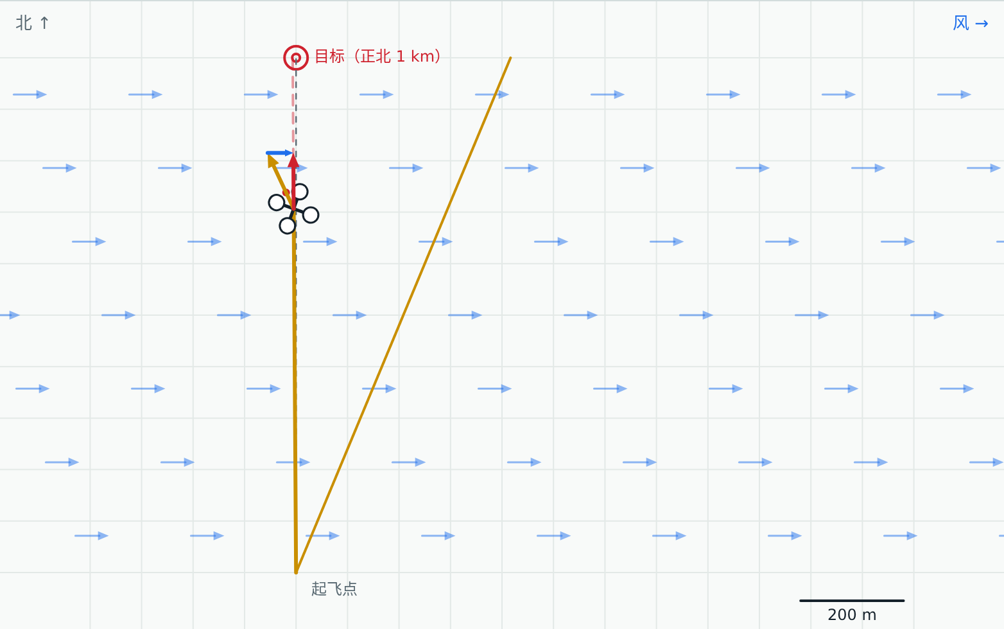
1.5 机器人问题 Robot problem
无人机侧风航线修正
Drone crosswind correction
巡检无人机要沿直线飞到正北 1 km 的目标，途中遇到东风侧风。机头要偏多少？要飞多久？
An inspection drone must fly straight to a target 1 km north through an easterly crosswind. How far must it turn into the wind, and how long will it take?
已知 Given
空速 12 m/s
airspeed 12 m/s
侧风 5 m/s
crosswind 5 m/s
航程 1 km
distance 1 km
本节结束时，我们用建立的模型回答这个问题。 We will answer it with this lesson’s model at the end.
Notes:
先让学生猜一猜、讨论 2 分钟，不急于给答案。本节最后回到这一页。
Let students guess and discuss for two minutes; do not give the answer yet. Return to this problem at the end of the lesson.

Slide 24
1.5 概念 Concept
相对运动：伽利略速度变换
Relative motion: Galilean velocity addition
同一质点在两个相对平动的参考系中速度不同
One particle has different velocities in two frames moving relative to each other
A 相对 C 的速度 = A 相对 B + B 相对 C
A rel. C = A rel. B + B rel. C
速度是矢量，按平行四边形（三角形）法则相加
Velocities add as vectors (parallelogram or triangle rule)
只适用于低速情况（远小于光速）
Valid only at speeds far below the speed of light
v_AC = v_AB + v_BC
Notes:
讲清公式的物理意义，再进入动画。
Explain the physical meaning of each formula before the animation.

Slide 25
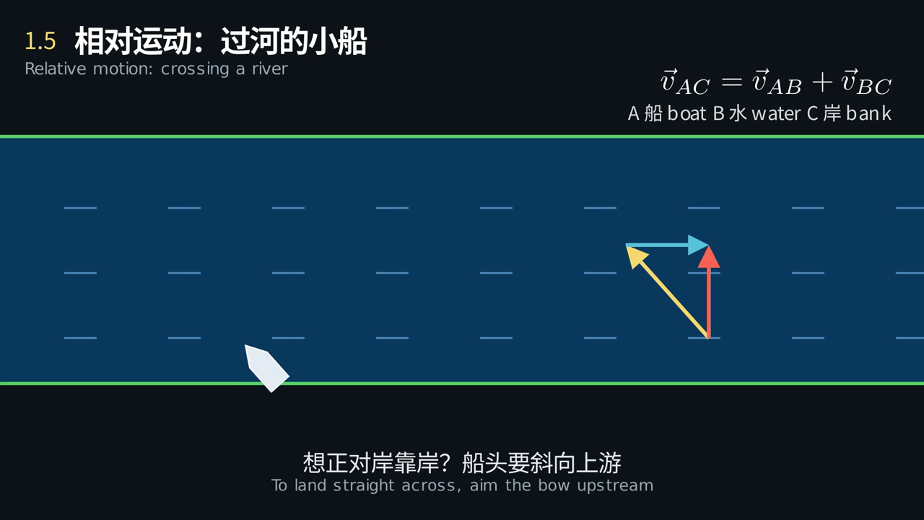
1.5 动画 Animation
船头垂直河岸，船为什么会被冲到下游？想正对岸靠岸该怎么办？
Why does the boat drift downstream, and how can it land straight across?
点击画面播放 · 中英字幕 · Click to play · bilingual captions
Notes:
播放动画，在关键画面暂停提问。
Play the clip and pause at the key frame to ask the question on the slide.

Slide 26
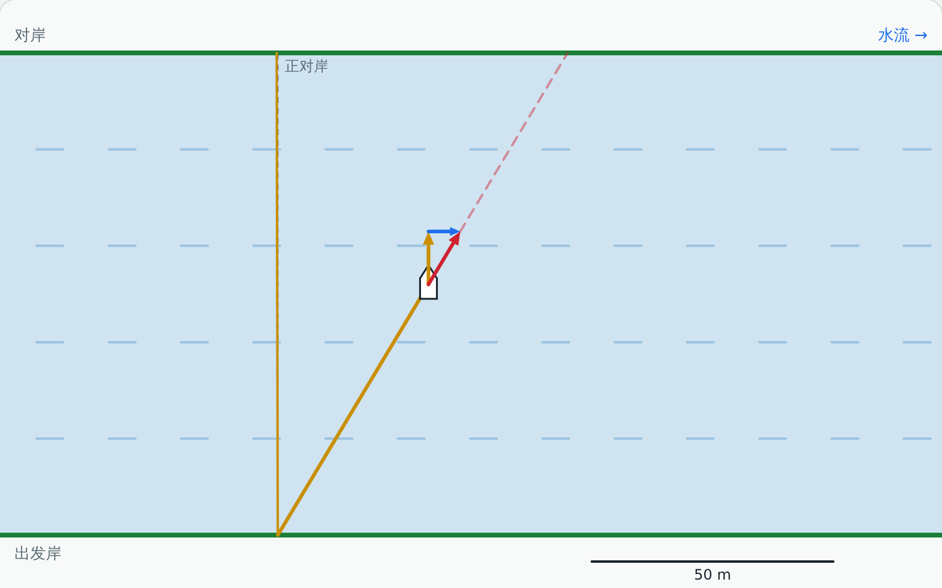
1.5 虚拟实验 Virtual lab
动手试一试：相对运动
Try it: Relative motion
任务 Tasks
无人机：侧风 5 m/s 直线飞到目标（偏差 ≤ 10 m）
Drone: fly straight to the target in a 5 m/s wind (within 10 m)
小船：正对岸靠岸（偏差 ≤ 2 m）
Boat: land straight across (within 2 m)
小船：水速 > 船速时能正对岸吗？
Boat: current faster than the boat—possible?
打开虚拟实验 Open lab ▶
课后按实验指导书完成实验报告 · Write the lab report using the lab guide
Notes:
课堂投屏演示一遍机器人场景，其余任务课后完成，并按实验指导书写实验报告。
Demonstrate the robot scene in class; students finish the tasks and the lab report after class.

Slide 27
1.5 回到实际问题 Back to the problem
建模求解：无人机侧风航线修正
Modelling: Drone crosswind correction
步骤 Step | 内容 What we do
① 问题 Problem | 巡检无人机要沿直线飞到正北 1 km 的目标，途中遇到东风侧风。机头要偏多少？要飞多久？ An inspection drone must fly straight to a target 1 km north through an easterly crosswind. How far must it turn into the wind, and how long will it take?
② 建模 Model | 无人机相对空气 12 m/s；风均匀恒定 5 m/s 向东；v(对地) = v(对空气) + v(风) Drone at 12 m/s relative to the air; steady 5 m/s wind to the east; v(ground) = v(air) + v(wind)
③ 求解 Solve | sinφ = 5/12，φ ≈ 24.6°；地速 √(12² − 5²) ≈ 10.9 m/s；用时 ≈ 91.7 s，比无风多 8.4 s sinφ = 5/12, φ ≈ 24.6°; ground speed √(12² − 5²) ≈ 10.9 m/s; time ≈ 91.7 s, 8.4 s longer than in still air
④ 检验 Check | 虚拟实验 1.5“无人机侧风”：φ = 25° 时到达点偏差约 6 m Lab 1.5 “drone crosswind”: at φ = 25° the miss is about 6 m
⑤ 修正 Improve | 风会变化，飞控要实时估计风速并修正航向；风速 15 m/s 大于空速时无法保持航线，应返航或改航 Wind changes, so the flight controller estimates it and corrects continuously; a 15 m/s wind exceeds the airspeed and the drone must return or reroute
生活中的例子
Everyday example
飞机侧风着陆时机头斜对跑道（“蟹行”），和小船过河是同一个速度三角形
Aircraft land in a crosswind with the nose angled off the runway (“crabbing”): the same velocity triangle as the river crossing
物理学通过建立模型来观察和描述世界：先简化，再求解，再用实验检验，最后找出模型的局限。
Physics describes the world through models: simplify, solve, test, then find where the model breaks.
Notes:
对照五步讲解，强调第⑤步：模型在哪里失效。实验报告第六部分按这五步写。
Walk through the five steps and stress step ⑤, where the model fails. Section 6 of the lab report follows the same steps.

Slide 28
例题 Worked example
质点沿半径 R = 0.10 m 的圆周运动，θ = 2 + 4t³（rad）。求 t = 2 s 时的切向加速度和法向加速度。
A particle moves on a circle of radius R = 0.10 m with θ = 2 + 4t³ (rad). Find aₜ and aₙ at t = 2 s.
ω = dθ/dt = 12t²，α = dω/dt = 24t
ω = dθ/dt = 12t², α = dω/dt = 24t
t = 2 s：ω = 48 rad/s，α = 48 rad/s²
At t = 2 s: ω = 48 rad/s, α = 48 rad/s²
aₜ = Rα = 0.10 × 48 = 4.8 m/s²
aₜ = Rα = 4.8 m/s²
aₙ = Rω² = 0.10 × 48² ≈ 230 m/s²（可在虚拟实验 1.4 中验证）
aₙ = Rω² ≈ 230 m/s² (check it in lab 1.4)
Notes:
先让学生独立做 3 分钟，再展开解答；最后打开虚拟实验 1.4 的“例1-3”模式对照。
Give students three minutes, then work through it and check with lab 1.4.

Slide 29
本章小结
Chapter summary
求导：r → v → a；积分：a → v → r（需要初始条件）
Differentiate r → v → a; integrate a → v → r with initial conditions
|Δr| ≠ Δs，速率 = ds/dt；采样定速度要权衡噪声与间隔
|Δr| ≠ Δs, speed = ds/dt; sampled speed trades noise against interval
抛体：x、y 分解；过定点求出手速度
Projectiles: split into x and y; solve for the launch speed through a point
圆周：aₙ = v²/R 决定转弯限速
Circles: aₙ = v²/R sets the cornering speed limit
相对运动：v_AC = v_AB + v_BC，用于跟踪抓取和航向修正
Relative motion: v_AC = v_AB + v_BC, for conveyor tracking and heading correction
课后作业：习题1 第1–6题 ＋ 5 个虚拟实验任务 ＋ 实验报告（任选一个机器人问题）
Homework: Problems 1–6 + the five virtual labs + one lab report on a robot problem
Notes:
回顾本章知识结构，提醒作业与实验报告的截止时间，预告下一章。
Review the chapter, remind students of the deadlines, and preview Chapter 2.

